Slide 1

Chapter 1 Problem Solving Techniques based on Computer

Slide 2
Outline
Learning Outcomes
Software development methods
Requirement specification and problem analysis
At the end of this chapter, student should be able to:
Analyse problem and identify the problem requirement (C4)
Use a problem analysis chart to consolidate data for a problem. (C3, CTPS)

Slide 3
Software Development Process

Slide 4
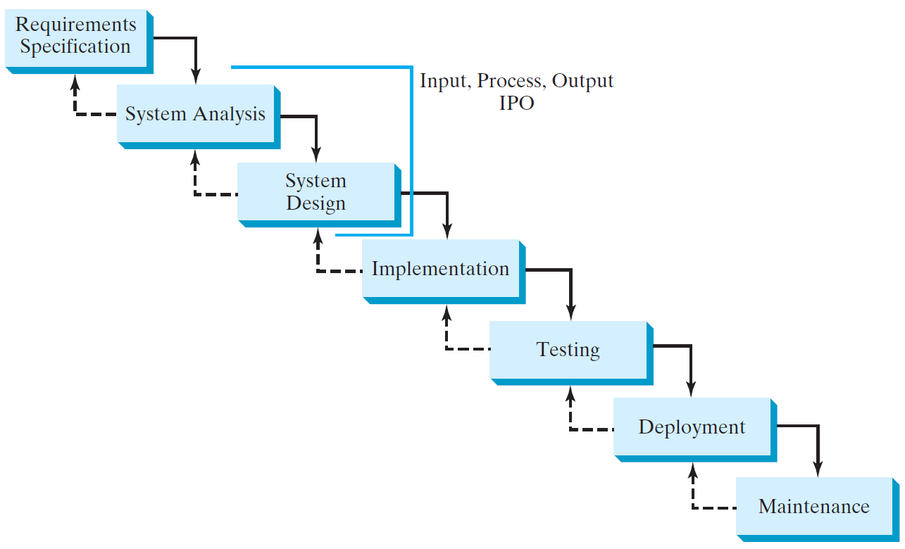
Software Development Process

Slide 5
Requirement Specification
A formal process that seeks to understand the problem and document in detail what the software system needs to do. This phase involves close interaction between users and designers.
Most of the examples in this book are simple, and their requirements are clearly stated. In the real world, however, problems are not well defined. You need to study a problem carefully to identify its requirements.

Slide 6
System Analysis
Seeks to analyze the business process in terms of data flow, and to identify the system’s input and output.
Part of the analysis entails modeling the system’s behavior. The model is intended to capture the essential elements of the system and to define services to the system.

Slide 7
System Design
The process of designing the system’s components.
This phase involves the use of many levels of abstraction to decompose the problem into manageable components, identify classes and interfaces, and establish relationships among the classes and interfaces.

Slide 8
IPO
The essence of system analysis and design is input, process, and output. This is called IPO.

Slide 9
Implementation
The process of translating the system design into programs. Separate programs are written for each component and put to work together.
This phase requires the use of a programming language like Java. The implementation involves coding, testing, and debugging.

Slide 10
Testing
Ensures that the code meets the requirements specification and weeds out bugs.
An independent team of software engineers not involved in the design and implementation of the project usually conducts such testing.

Slide 11
Deployment
Deployment makes the project available for use.
For a Java program, this means installing it on a desktop or on the Web.

Slide 12
Maintenance
Maintenance is concerned with changing and improving the product.
A software product must continue to perform and improve in a changing environment. This requires periodic upgrades of the product to fix newly discovered bugs and incorporate changes.

Slide 13
Problem solving concept

Slide 14
Concept and organization of problem solving
What problem can be solved by computer
When the solution can be produced by a set of step-by-step procedures or actions.
This step-by-step action is called an algorithm.
The algorithm will process some inputs and produced output.
Solving problem by computer undergo two phases:
Phase 1:
Organizing the problem or pre-programming phase.
Phase 2:
Programming phase.

Slide 15
Pre-Programming Phase
This phase involves:
Analyzing the problem – Problem Analysis Chart (PAC)
Developing the Input-Process-Output (IPO) Chart.
Writing the algorithms.
Drawing the flowchart, or
Pseudocode

Slide 16
Pre-Programming Phase
(1) Analyzing the Problem
Understand requirements:
The given data
The required results
The processing that is required in the problem
A list of solution alternatives

Slide 17
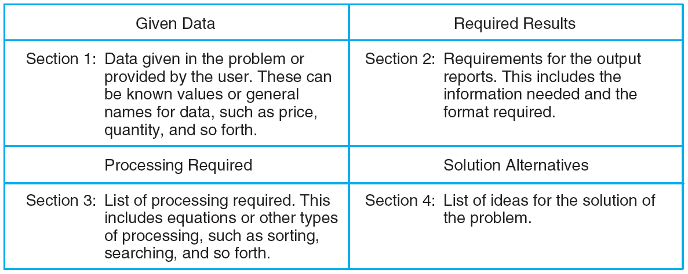
Problem Analysis Chart

Slide 18
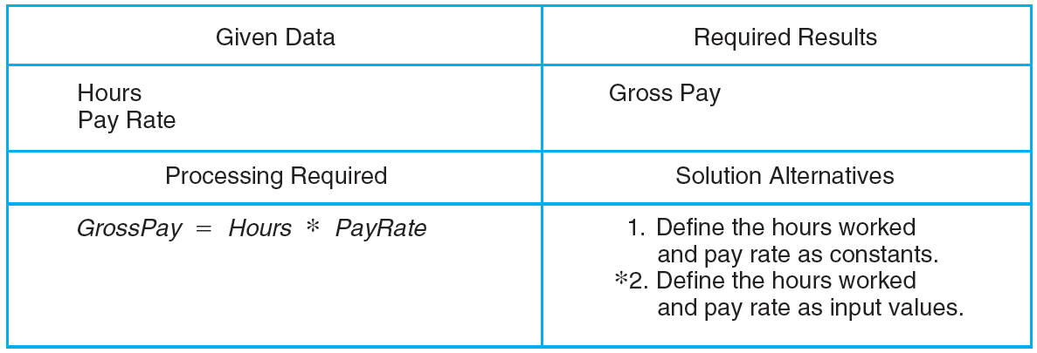
Example: Problem Analysis Chart for the Payroll Problem

Slide 19
Pre-Programming Phase
All these requirements can be presented in a Problem Analysis Chart (PAC)
Data | Processing | Output
Given in the problem or provided by the user | List of processing required or procedures. | Output requirement.

Slide 20
Pre-Programming Phase
Example 1: Payroll Problem
Calculate the salary of an employee who works by hourly basis.
The formula to be used is
Salary = Hours worked * Pay rate
Data | Processing | Output
Hours worked, Pay rate | Calculate Salary = Hours worked * Pay rate | Salary

Slide 21
Problem 1
Write a Problem Analysis Chart (PAC) to convert the distance in miles to kilometers where 1.609 kilometers per mile.
Data | Processing | Output
Distance in miles | Calculate kilometers: kilometers = 1.609 x miles | Distance in kilometers

Slide 22
Problem 2
Write a Problem Analysis Chart (PAC) to find an area of a circle where
area = pi * radius * radius
Data | Processing | Output
radius | Calculate area: area = pi * radius * radius | area

Slide 23
Problem 3
Write a Problem Analysis Chart (PAC) to compute and display the temperature inside the earth in Celsius and Fahrenheit. The relevant formulas are
Celsius = 10 x (depth) + 20
Fahrenheit = 1.8 x (Celsius) + 32
Data | Processing | Output
depth | Calculate celsius: celsius = 10 x depth + 20 Calculate fahrenheit: fahrenheit = 1.8 x celsius)+ 32 | Temperature in celsius Temperature in fahrenheit

Slide 24
Problem 4
Write a problem analysis chart (PAC) that gets from a user the distance of a trip in miles, the miles per gallon estimate for the user’s car, and the average cost of a gallon of fuel. Calculate and display the number of gallons of fuel needed and the estimated cost of the trip.
Data | Processing | Output
distance, miles per gallon, cost per gallon | Calculate total fuel = distance / miles per gallon Calculate estimated cost = cost per gallon x total fuel | total fuel, estimated cost

Slide 25
Pre-Programming Phase
(2) Developing the Input Process Output (IPO) Chart
Extends and organizes the information in the Problem Analysis Chart.
It shows in more detail what data items are input, what are the processing or modules on that data, and what will be the result or output.

Slide 26
Developing IPO Chart
Has four sections:
Input
Contains all input data from the problem analysis chart
Processing
Contains all processing, evident and implied, from problem analysis chart
Module/method Reference
Contains number for method reference
Output
All required output as designated by the problem and/or the user

Slide 27
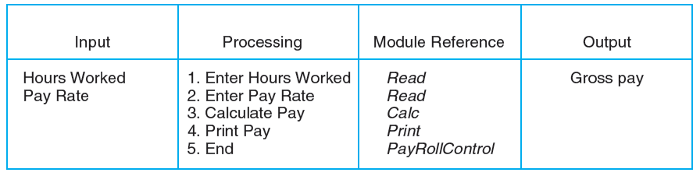
The IPO Chart for the Payroll Problem

Slide 28
Pre-Programming Phase
Example 1: Payroll Problem
PAC
IPO
Data | Processing | Output
Hours worked, Pay rate | Calculate Salary = hours worked x pay rate | Salary
Input | Processing | Output
- Hours Worked - Pay Rate | - Enter Hours Worked - Enter Pay Rate - Salary = Hours worked * pay rate - Print Salary - End | Salary

Slide 29
Problem 1
Data | Processing | Output
Distance in miles | Calculate kilometers = 1.609 x miles | Distance in kilometers
Input | Processing | Output
Distance in miles | - Enter distance - Kilometers = 1.609 x distance - Print kilometers - End | Distance in kilometers
Write a Input Process Output (IPO) to convert the distance in miles to kilometers where 1.609 kilometers per mile.
PAC
IPO

Slide 30
Problem 2
Write a Input Process Output (IPO) to find an area of a circle where
area = pi * radius * radius
PAC
IPO
Data | Processing | Output
radius | Calculate area = pi * radius * radius | area
Input | Processing | Output
radius | - Enter radius - area = 3.14 x radius x radius Print area End | area

Slide 31
Problem 3
Write an Input Process Output (IPO) to compute and display the temperature inside the earth in Celsius and Fahrenheit. The relevant formulas are
Celsius = 10 x (depth) + 20
Fahrenheit = 1.8 x (Celsius) + 32

Slide 32
PAC
Data | Processing | Output
depth | Calculate celsius: celsius = 10 x depth + 20 Calculate fahrenheit: fahrenheit = 1.8 x celsius)+ 32 | Temperature in celsius, Temperature in fahrenheit
IPO
Input | Processing | Output
depth | - Enter depth celsius = 10 x (depth) + 20 fahrenheit = 1.8 x (celsius) + 32 Display celsius Display fahrenheit End | Temperature in celsius, Temperature in fahrenheit

Slide 33
Problem 4
Write an Input Process Output (IPO) that asks a user to enter the distance of a trip in miles, the miles per gallon estimate for the user’s car, and the average cost of a gallon of fuel. Calculate and display the number of gallons of fuel needed and the estimated cost of the trip.
PAC
Data | Processing | Output
distance, miles per gallon, cost per gallon | Calculate total fuel = distance / miles per gallon Calculate estimated cost = cost per gallon x total fuel | total fuel, estimated cost

Slide 34
IPO
Input | Processing | Output
Distance in miles Miles per gallon Cost fuel per gallon | Enter distance Enter miles per gallon total fuel = distance / miles per gallon Enter cost fuel per gallon estimated cost = cost per gallon x total fuel Display total fuel Display estimated cost End | Total fuel Estimated cost

